Slide 1
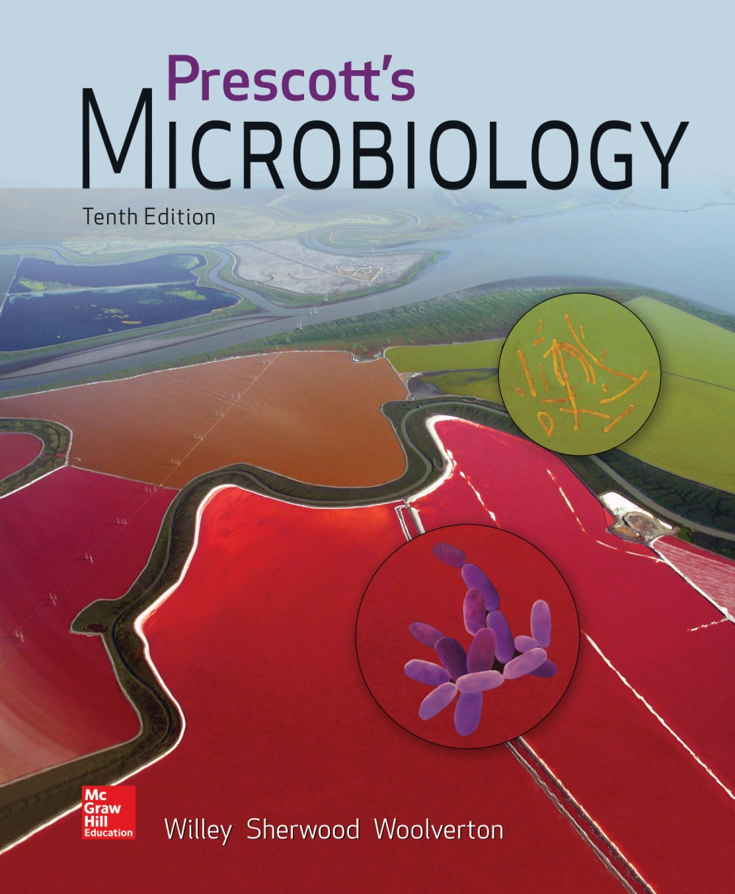
Chapter 35 – Pathogenicity and Infection

Slide 2
35.1 Pathogenicity Drives Infectious Disease
Compare and contrast competition between microbial species with competition between microbial and human cells
Predict the microbial virulence factors and host cell responses that result in disease
Relate the infectious disease process to time, identifying events associated with each stage of the process

Slide 3
Pathogenicity and Infectious Disease
Host – larger organism that supports the survival and growth of a smaller organism
Parasites are organisms that
live on or within a host organism and are metabolically dependent on the host
are any organism that cause disease

Slide 4
Pathogenicity and Infectious Disease
Infection
a parasite growing and multiplying within/on a host
may or may not result in overt infectious disease
Pathogen
any parasitic organism causing infectious disease
primary (frank) pathogen – causes disease by direct interaction with healthy host
opportunistic pathogen – may be part of normal flora and causes disease when it has gained access to other tissue sites or host is immunocompromised
Pathogenicity
ability of parasite to cause disease

Slide 5
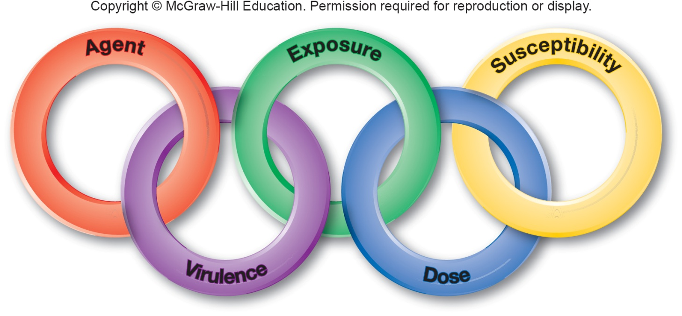
The Chain of Infection
Chain of events for a successful infection
agent identity
virulence of agent
means of exposure to agent
dose of agent
susceptibility of host to agent

Slide 6
Sources of Pathogens
Can be animate (other humans or animals)
infections passed from animal to human are termed zoonoses
many examples of zoonoses exist (see tables on next two slides)
Can be inanimate (water, soil, food)
Reservoir = natural environmental location in which the pathogen normally resides

Slide 7
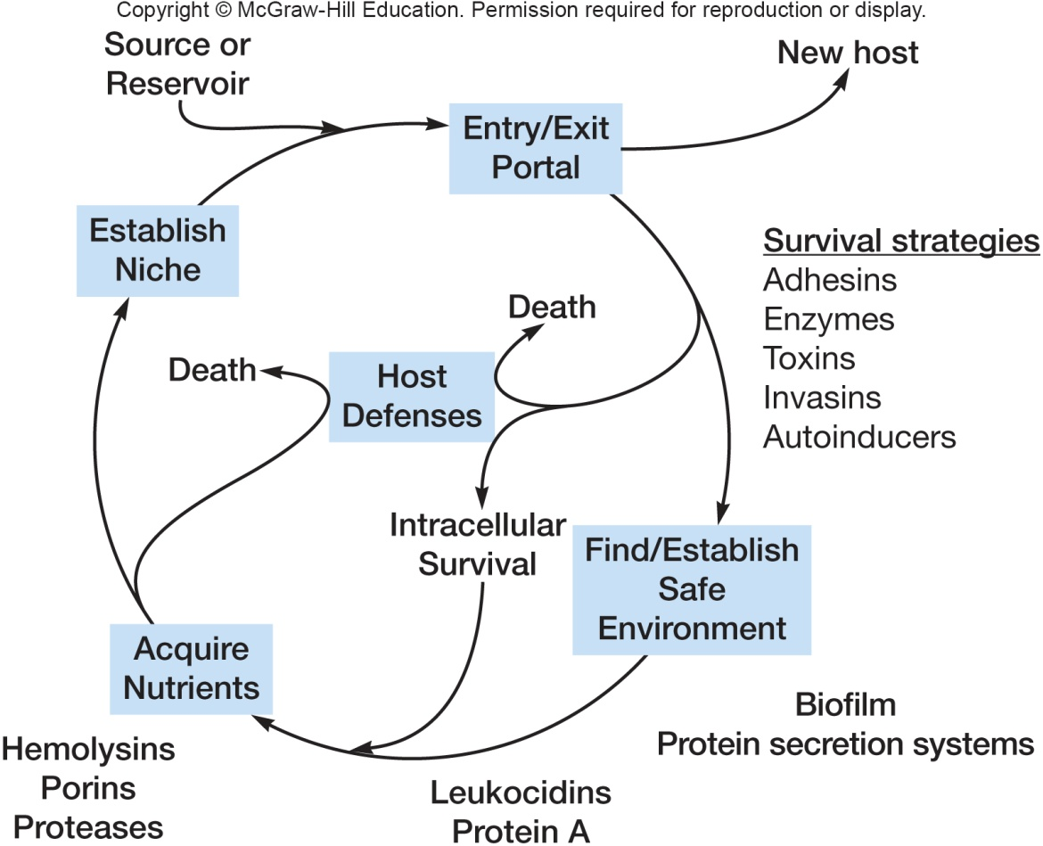
Infectious Process
A pathogen must contact a host AND survive within it to cause a disease. To survive, it needs:
a suitable environment
a source of nutrients
in competition with
eukaryotic host cells
protection from harmful
elements
virulence factors allow
a pathogen to outcompete
host cells and resist their defenses

Slide 8
Toxigenicity
Some microbes possess toxigenicity
ability to produce toxins
Toxin
specific substance that damages host
Intoxications
diseases that result from entry of a specific preformed toxin into host
Toxemia
condition caused by toxins in the blood of host

Slide 9
Course of Infectious Disease – Important Terms
Infectious disease
infection with viruses, bacteria, fungi, protozoa, and helminths
Signs
objective changes in body that
can be directly observed
Symptoms
subjective changes experienced by patient
Disease syndrome
set of characteristic signs and symptoms

Slide 10
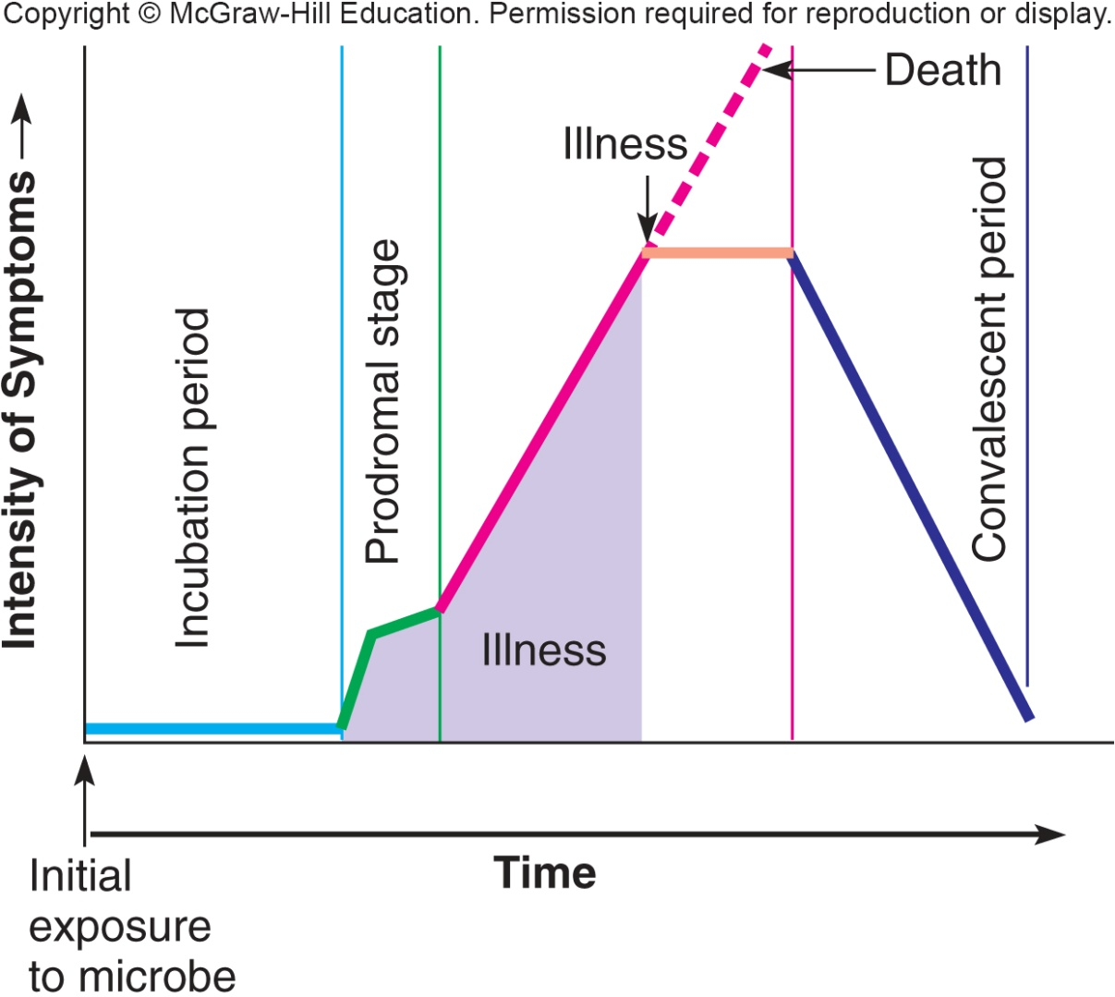
Timecourse of Infectious Disease
Incubation period
period after patho-
gen entry, before
signs and symptoms
Prodromal stage
onset of signs and
symptoms
not clear enough for diagnosis
Period of illness
disease is most severe, signs and symptoms
Convalescence
signs and symptoms begin to disappear

Slide 11
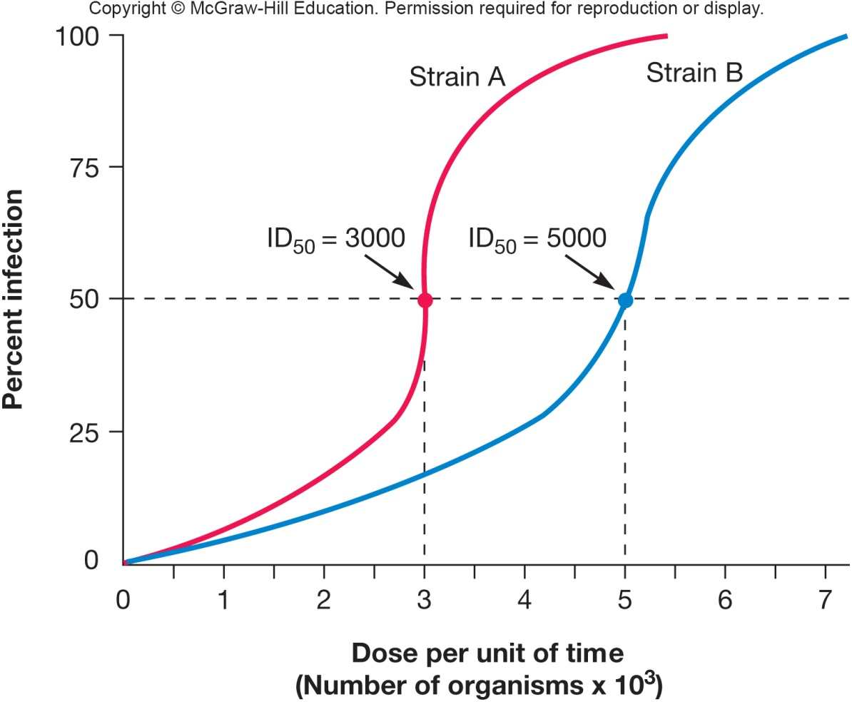
Infectious Dose
Infectious dose 50 (ID₅₀)
number of pathogens that will infect 50% of an experimental group of hosts in a specified time
varies with pathogen
handwashing reduces number of pathogens

Slide 12
Lethal Dose
Lethal dose 50 (LD₅₀)
dose that kills 50% of experimental animals within a specified period
Cytopathology – cellular changes
Can be used to observe cells in tissue culture for death rates rather than entire organisms
Examining virulence factors and their release

Slide 13
Host Susceptibility
Two main factors
defense mechanisms of host (discussed in Chs. 33 and 34)
pathogenicity of pathogen
Nutrition, genetic predisposition, and stress also play a role in host susceptibility to infection

Slide 14
Growth Rate – Extracellular vs. Intracellular Pathogens
Pathogen must find most favorable conditions in the host
extracellular pathogens
grow outside cells in blood, tissue fluids
intracellular pathogens
grow and multiply within cells
facultative intracellular pathogens
grow within or outside cells
obligate intracellular pathogens
only grow when inside cells

Slide 15
35.2 Virulence Defines a Pathogen’s Success
Identify and describe the features that allow microorganisms to overcome host resistance and immunity
Discuss the strategies microorganisms have evolved to exploit human cells and tissues as resources for their survival
Compare the molecular mechanisms by which microorganisms adhere to and invade human cells and tissues
Illustrate the mechanisms by which microbial toxins impact human cells
Model disease processes and explain virulence

Slide 16
Virulence
Degree or intensity of pathogenicity
Virulence factors
determine the degree to which the pathogen causes damage, invasion, infectivity
Determined in part by pathogen’s ability to survive outside host

Slide 17
Pathogenicity Islands
Major virulence factors on large segments on chromosomal or plasmid DNA
increase bacterial virulence
absent in nonpathogenic members
common sequence characteristics
insertion-like sequences for mobility
G + C content different from bacterial genome
several open reading frames
can be spread through horizontal transfer of virulence genes to bacteria

Slide 18
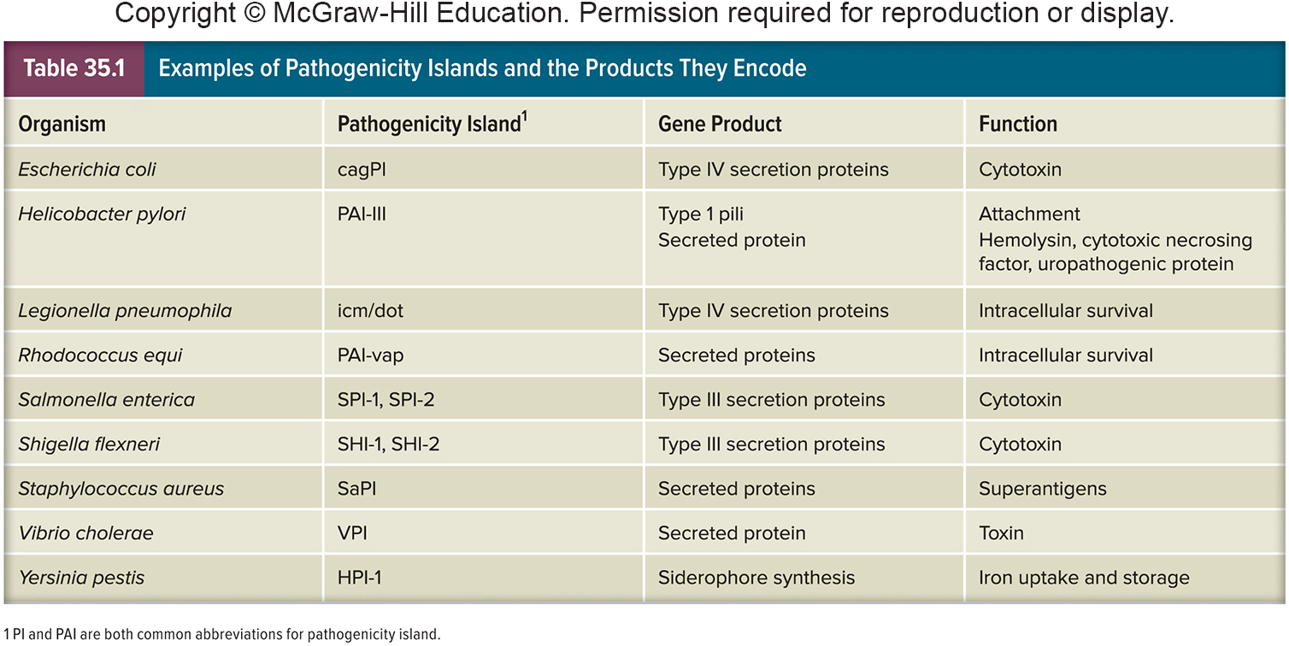
Examples of Pathogenicity Islands

Slide 19
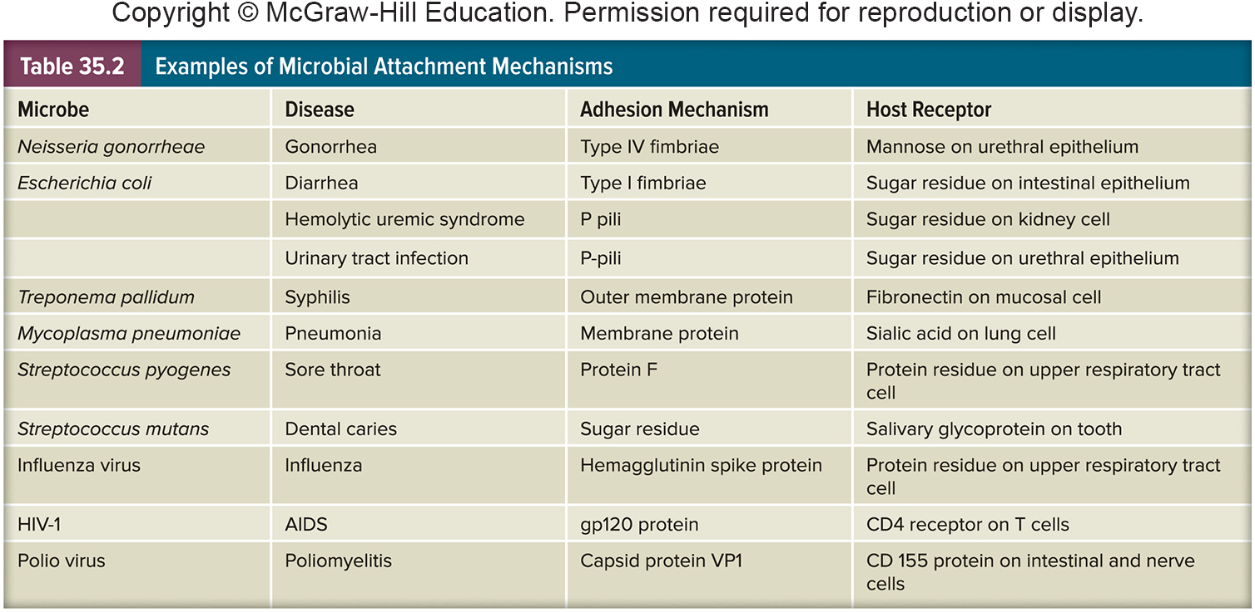
Virulence Factors
Animal model systems may be used to determine role of virulence factor in disease process
Determined by characteristics of the pathogen
adherence and colonization
invasion

Slide 20
Adherence and Colonization
First step in disease is entrance and attachment
Portal of entry
skin, respiratory, gastrointestinal, urogenital systems, or conjunctiva of eye
vector borne, sexual contact, blood transfusion, or organ transplant
Adherence
mediated by special molecules called adhesins
Colonization
a site of microbial reproduction on or within host
does not necessarily result in tissue invasion or damage

Slide 21
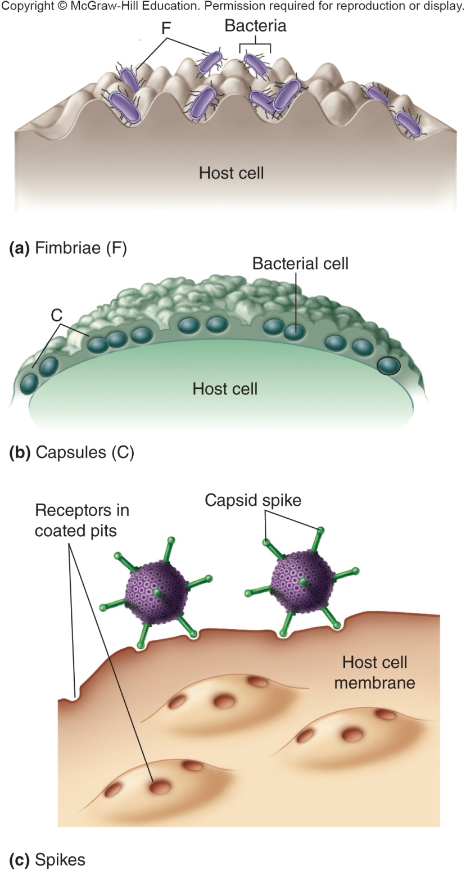
Attachment and Colonization
Adherence structures
pili, fimbriae (adhesion molecules on bacterium’s cell surface) bind complementary receptor sites on host cell surface
Colonization
a site of microbial reproduction on/in host
does not necessarily result in tissue damage

Slide 22
Invasion
Infectivity - ability to create a discrete point of infection
Invasiveness - ability to spread to adjacent tissues
Penetration can be active or passive
active occurs through lytic substances which
attack the extracellular matrix and basement membranes of integuments and intestinal linings
degrade carbohydrate-protein complexes between cells
disrupt host cell surface
passive (e.g. skin lesions, insect bites, wounds)
spread to deeper tissues involves production of specific products and/or enzymes that promote spreading

Slide 23
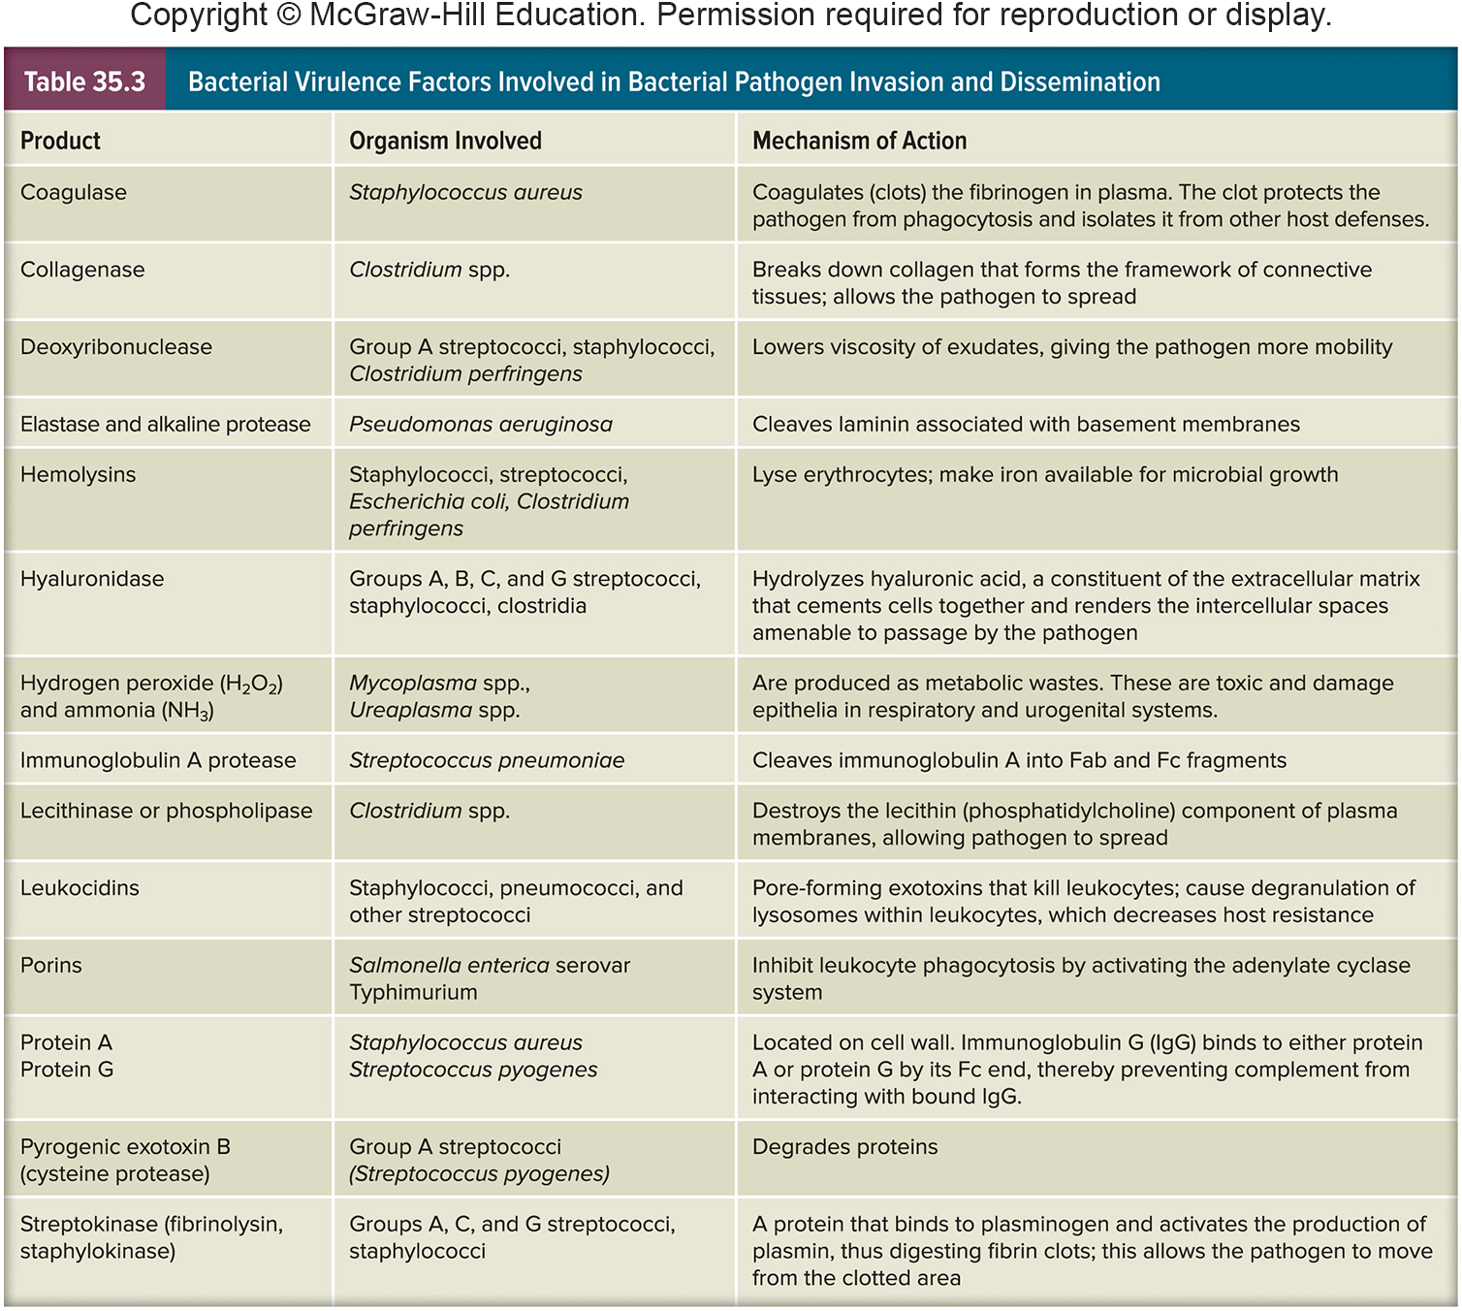
Microbial Invasion Virulence Factors

Slide 24
Invasion – Specific Examples
Once in circulatory system, bacteria have access to all organs and systems
bacteremia – presence of viable bacteria in the blood
septicemia –pathogens or their toxins in the blood
varies among pathogens
e.g. Clostridium tetani (tetanus) produces a number of virulence factors but is non-invasive
e.g. Bacillus anthracis (anthrax) and Yersinia pestis (plague) also produce many virulence factors and are highly invasive
e.g. Streptococcus spp. span the spectrum of virulence factors and invasiveness

Slide 25
Exotoxins
Soluble, heat-labile, proteins
Secreted into surroundings as pathogen grows
Most exotoxin producers are Gram-negative
Often travel from site of infection to other tissues or cells where they exert their effects
Usually synthesized by specific bacteria that have toxin genes in their plasmids or prophage DNA

Slide 26
Exotoxins - 2
Among the most lethal substances known
Are highly immunogenic
Stimulate production of neutralizing Ab (antitoxins)
Chemically inactivated to form immunogenic toxoids
e.g. tetanus toxoid

Slide 27
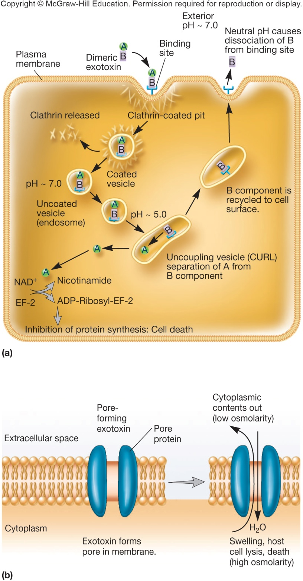
Types of Exotoxins
AB exotoxins
composed of two subunits
A subunit – responsible for toxic effect
B subunit – binds to specific target cell
Specific host site exotoxins
Membrane-disrupting exotoxins
Superantigens

Slide 28
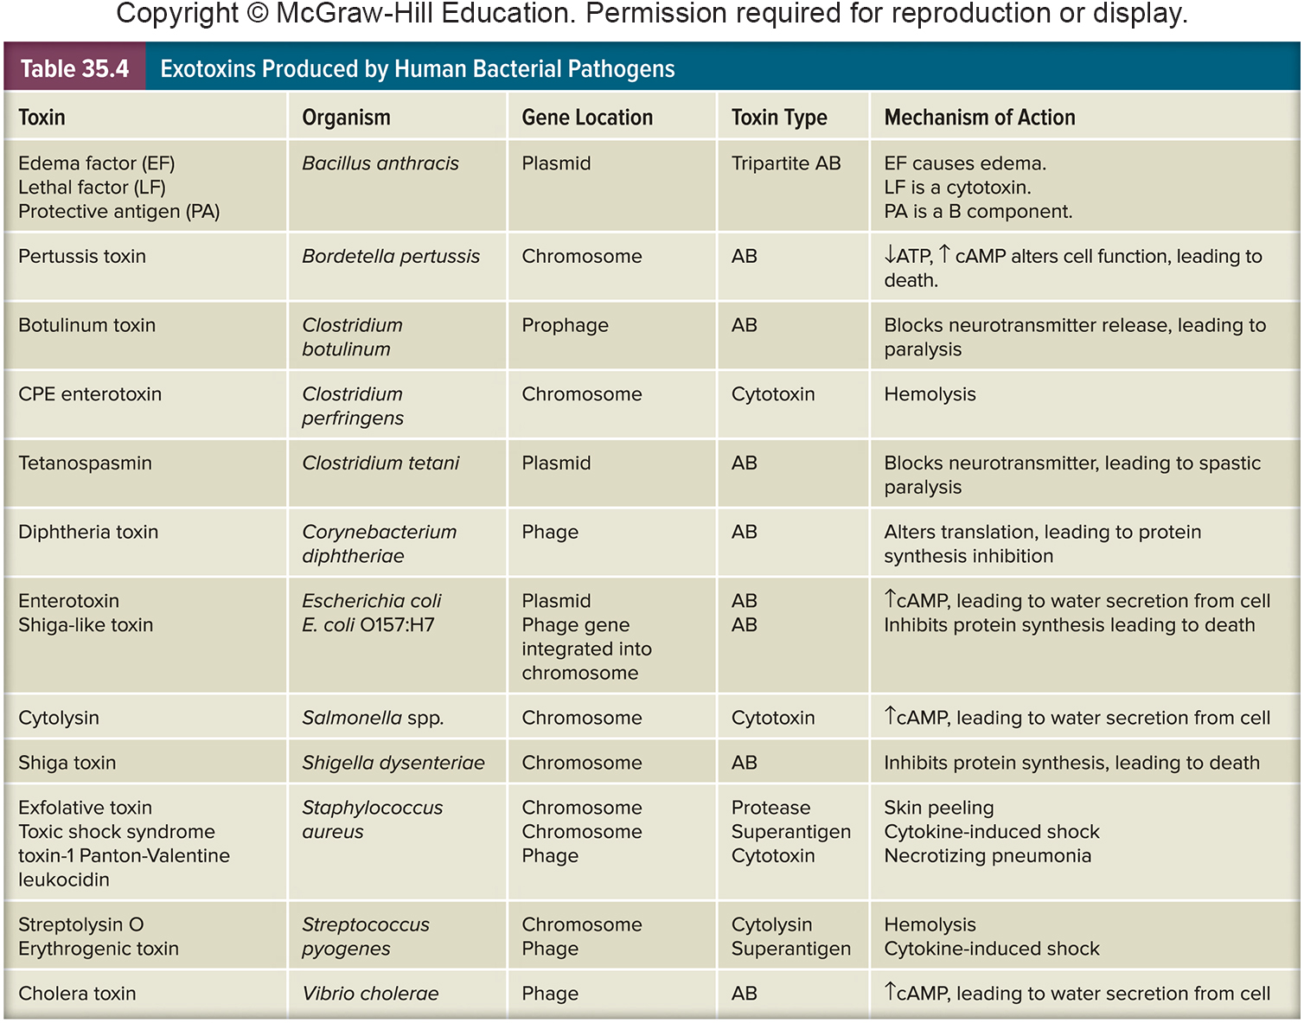
Exotoxins Produced By Human Pathogens

Slide 29
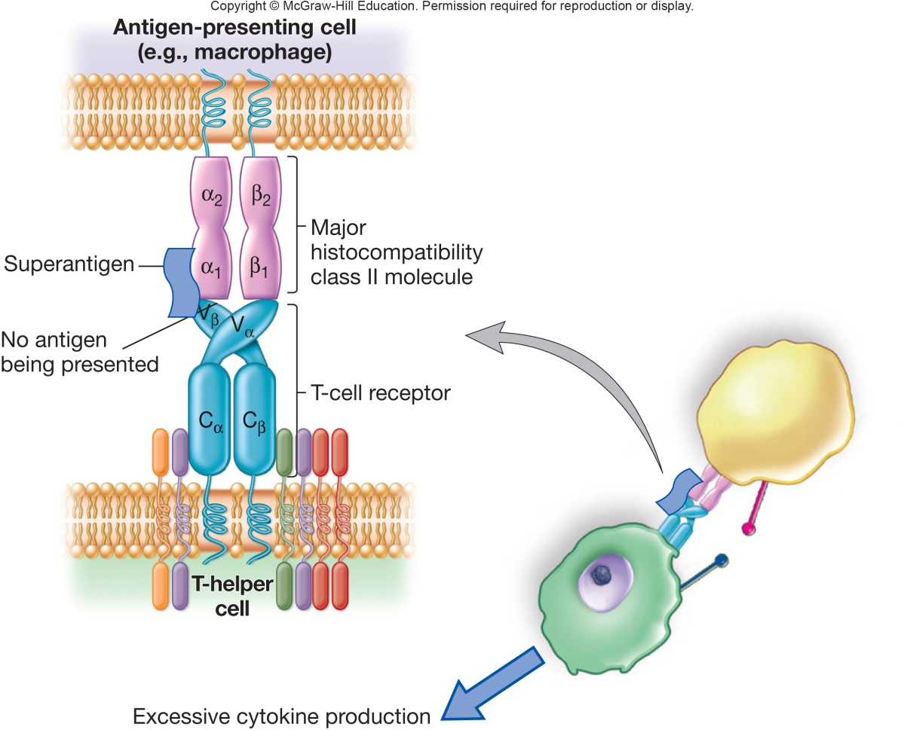
Superantigens
Stimulate ~30% of T cells of the immune system
causes the T cells to overexpress and release cytokines
results in failure of multiple host organs allowing time for the microbe to disseminate
Example is staphylococcal enterotoxin B

Slide 30
Endotoxin - Lipopolysaccharide
Lipopolysaccharide (LPS) in Gram-negative cell wall can be toxic to specific hosts
called endotoxin because it is an endogenous (part) of the bacterium and released when organism lyses
some is also released during multiplication
toxic component is the lipid portion, lipid A

Slide 31
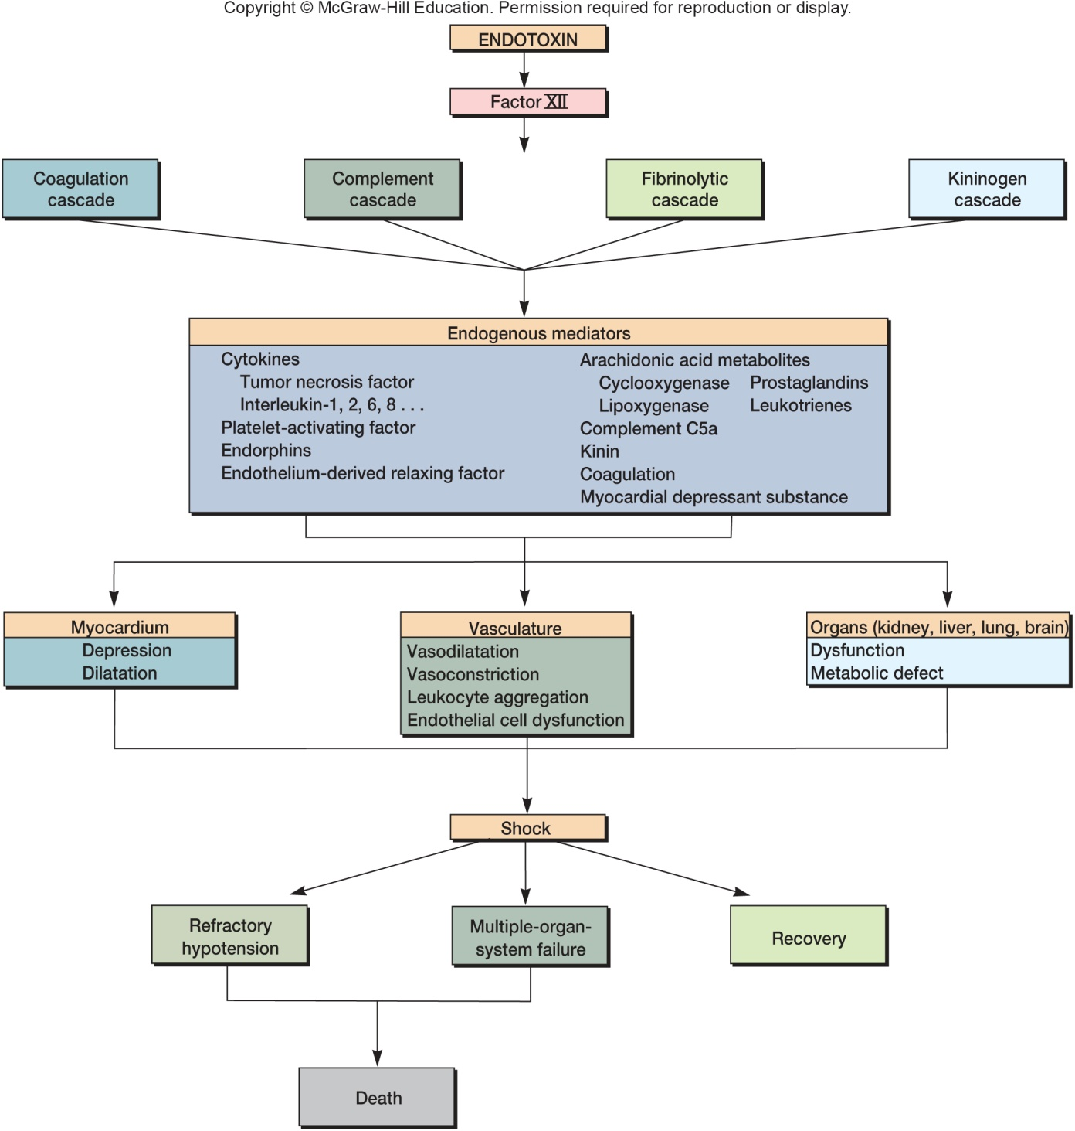
The Septic Shock Cascade

Slide 32
Endotoxins: General Features
Heat stable
Toxic (nanogram amounts)
Weakly immunogenic
Generally similar, despite source
Cause general system effects
fever, weakness, diarrhea, inflammation, intestinal hemorrhage, and fibrinolysis, the enzymatic breakdown of fibrin, the major protein component of blood clots

Slide 33
Endotoxins: General Features – 2
Bring about these effects indirectly
endotoxin interacts with host molecules and cells, activating host systems
coagulation, complement, fibrinolytic, and kininogen system
e.g. interaction with macrophages → release of endogenous pyrogen (induces fever)
e.g. binding to LPS-binding protein → release of cytokines
tumor necrosis and others lead to septic shock

Slide 34
Mycotoxins
Secondary metabolites of fungi
common contaminants of food crops
Aspergillus flavus and A. parasiticus produce carcinogenic aflatoxin
Stachybotrys produce tissue-damaging satratoxins
Claviceps purpurea (ergot) produce hallucinogen lysergic acid (LSD)

Slide 35
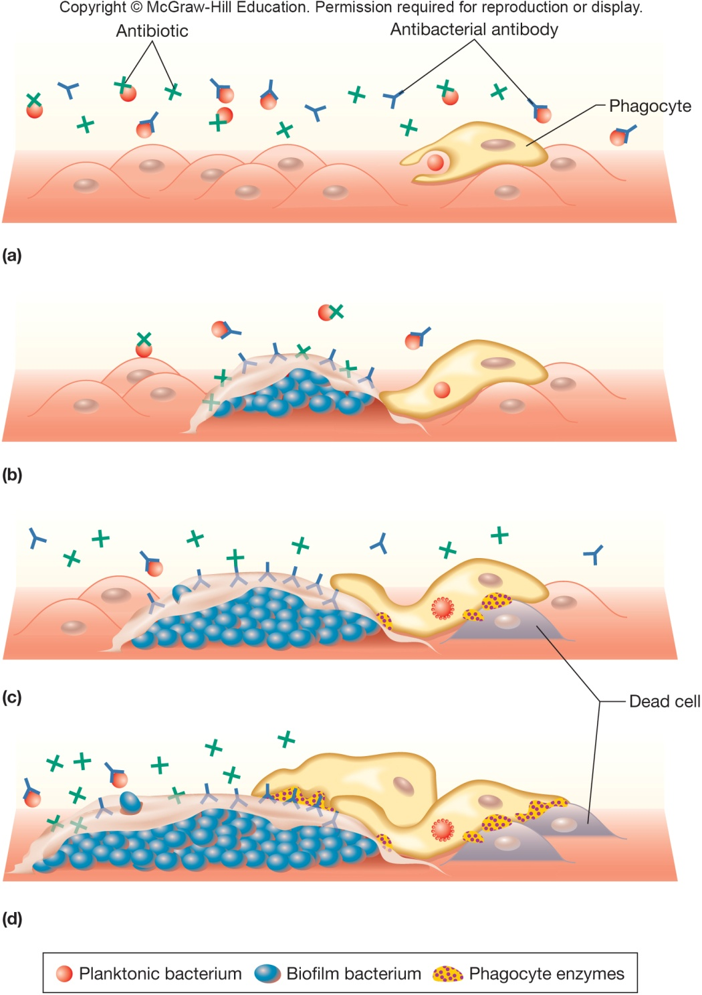
Biofilm Development
Biofilm growth is physiologically different from planktonic growth
may cause chronic infection
increases virulence
become less sensitive to antibiotics
make cells in biofilm more resistant to host defense (“frustrates” phagocytes)

Slide 36
Resisting Host Defenses
Most microbes eliminated before they can cause disease due to immune system
Successful pathogen evades immune system
Numerous mechanisms for both viral and bacterial pathogens
infection of immune system cells, diminishing function
fuse with adjacent cells to prevent exposure to antimicrobial proteins in host
capsules prevent phagocytosis
mutations change antigenic sites or alter expression of antigens
through downregulation or phase variation
produce substances that resemble host tissue
produce proteases that degrade host proteins
special proteins that interfere with host defenses

Slide 37
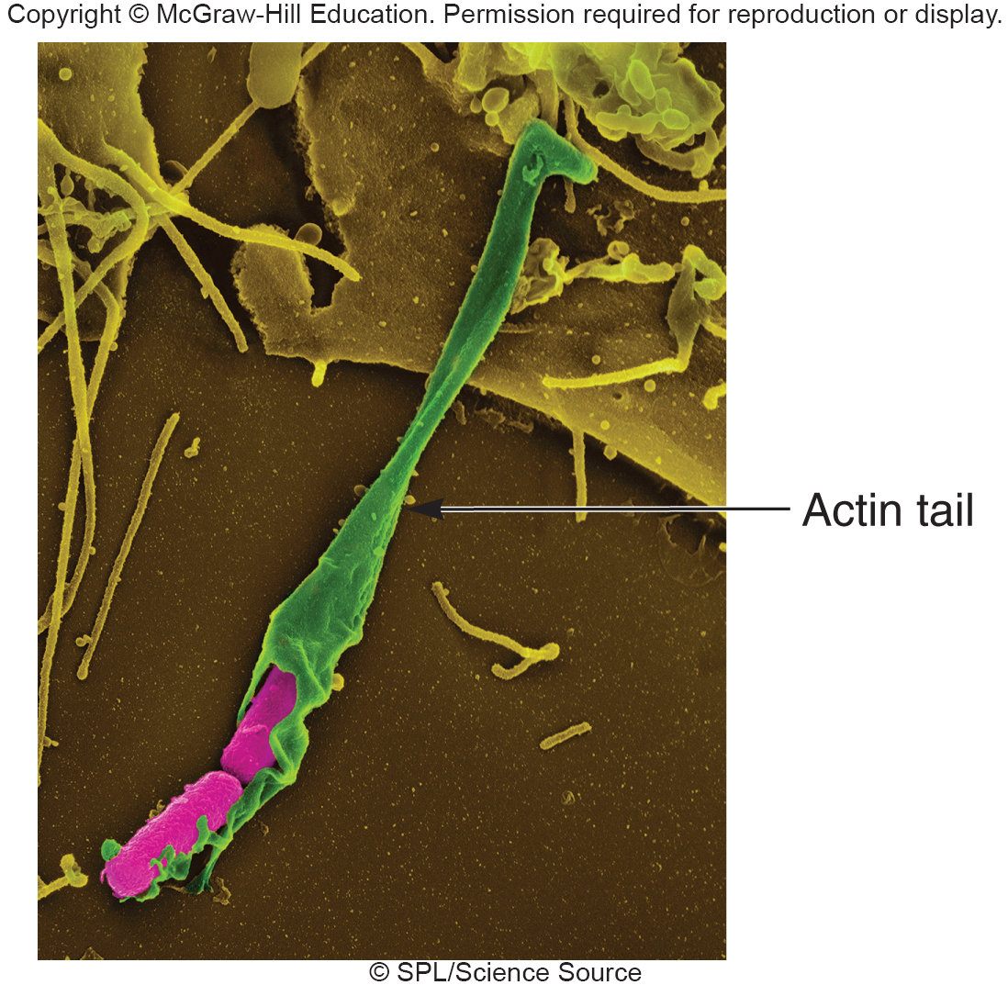
More Ways of Resisting Host Defenses
Production of decoy proteins to bind available neutralizing antibodies
Lengthened O-chains to prevent host detection or lysis
Some survive inside
host cells
eject themselves from
cell to cell using host
actin

Slide 38
35.3 Exposure and Transmission Can Lead to Infectious Disease
List and describe the means by which microorganisms access humans to cause disease
Correlate initial microbial numbers and replication rates to infection and lethality
Synthesize a concept map of the infectious process

Slide 39
Pathogen Transmission
Initial transmission of pathogen to host
evidence suggests correlation between mode of transmission and degree of virulence
direct contact → less virulent
vector-borne → highly virulent in human host; relatively benign in vector
greater ability to survive outside host → more virulent
Transmission from host to host
Transmission alone not enough for infection to occur
Tropism - pathogen must make contact with appropriate host tissue
determined by specific cell surface receptors

Slide 40
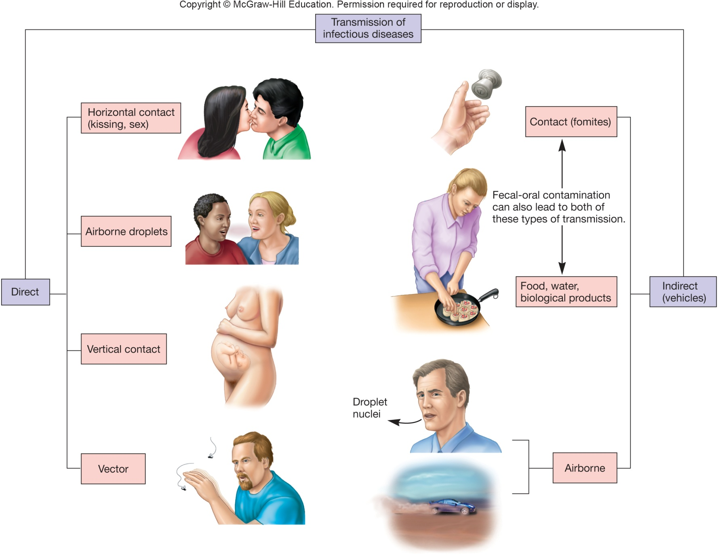
Transmission of Infectious Diseases
From mother to fetus

Slide 41
Pathogen Transmission – Main Modes
Five main modes of transmission
airborne
contact
vehicle
vector borne
vertical

Slide 42
Airborne Transmission
Pathogen suspended in air and travels ≥1 meter
Droplet nuclei
small particles (1–4 μm diameter)
can remain airborne for long time
can travel long distances
usually propelled from respiratory
tract of source organisms by sneezing, coughing, or
vocalization
Dust particles also important route of airborne transmission

Slide 43
Contact Transmission
Coming together or touching of source/reservoir and host
Direct contact (person-to-person)
physical interaction between source/reservoir and host
e.g., kissing, touching, and sexual contact
Indirect contact
involves an intermediate (usually inanimate)
e.g., eating utensils, bedding
Droplet spread
large particles (>5 μm) that travel <1 meter

Slide 44
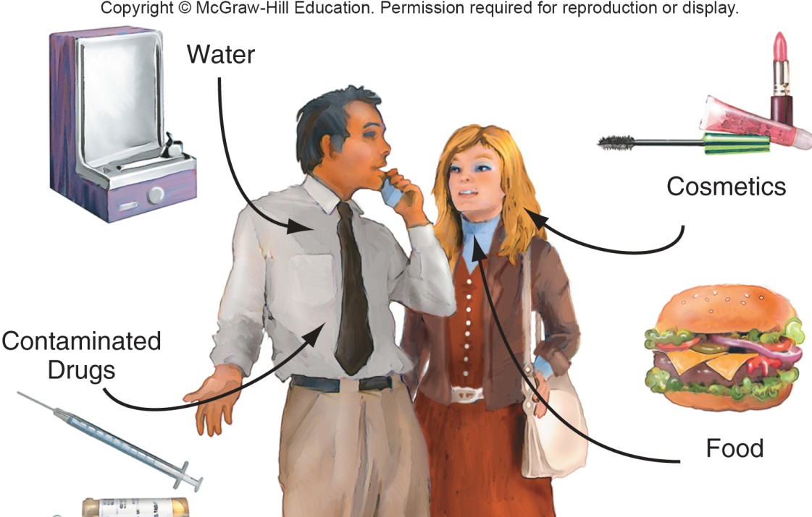
Vehicle Transmission
Vehicles
inanimate materials or objects involved in pathogen transmission
Common vehicle transmission
single vehicle spreads pathogen to multiple hosts
e.g., water and food
Fomites
common vehicles such as surgical instruments, bedding, and eating utensils

Slide 45
Vector-Borne Transmission
External (mechanical) transmission
passive carriage of pathogen on body of vector
no growth of pathogen during transmission
Internal transmission
carried within vector
harborage transmission – pathogen does not undergo changes within vector
biologic transmission – pathogen undergoes changes within vector

Slide 46
Vertical Transmission
Occurs when the unborn child acquires a pathogen from an infected mother
Not as common as horizontal transmission
Babies born with an infectious disease are said to have a congenital infection
Examples include
gonorrhea (especially in the eyes)
herpes
German measles (rubella)
toxoplasmosis

Slide 47
Take Home Message
If you understand the basic idea of the chain of infection, you can categorize and better understand any disease
Understanding where the weak links in the chain of infection lie allow you to break those links
When you work with this material, try to think forward to different disease states, using them for examples – ask yourself what would be the easiest way to “break the chain of infection” and control a disease state

